Slide 1
Unit 3: Data Visualization
Visualization Design Principles,
Tables,
Univariate Data Visualization, Multivariate Data Visualization,
Visualizing Groups, Dynamic Techniques General Matplotlib Tips,
Two Interfaces for the Price of One,
Simple Line Plots,
Visualizing Errors, Density and Contour Plots, Histograms,
Binning, and Density, Customizing Plot Legends,
Customizing Color bars, Multiple Subplots, Text and Annotation, Customizing Matplotlib.

Slide 2
Visualizing Groups, Dynamic Techniques General Matplotlib Tips

Slide 3
Data visualization
we can use Groupby & Aggregate functions with the matplotlib and seaborn functions to make beautiful graphic representations of our data.
Groupby Function
Groupby function is applied on a dataset and provides the set of grouped datasets based on column values. In simple terms, if any column has a set of values, then we want a smaller dataset where each smaller dataset contains each type of value based on that column.
Let’s say we have a dataset where we have a column named “Region,” and we want the set of datasets where each smaller datasets represent each region.

Slide 4
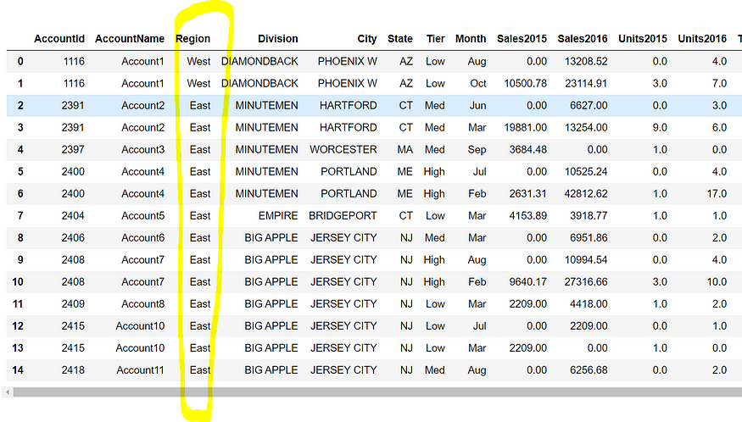

Slide 5
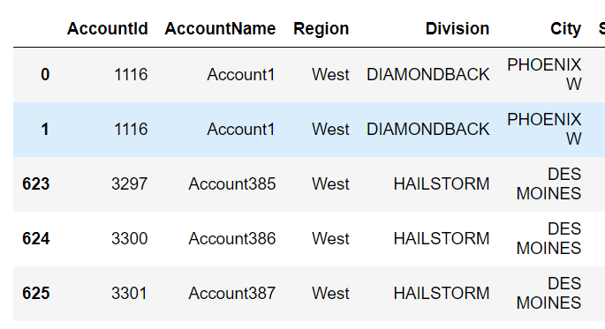
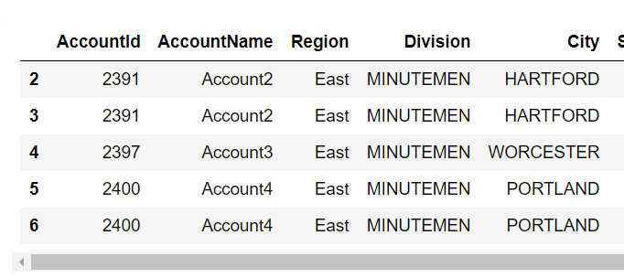
We can use the following code:
test=sales.groupby(by=["Region"])
Here, the main dataset name is sales that have a column named “Region.” We can utilize the get_group function to grab specific groups, as follows:
test.get_group("East")
test.get_group("West")

Slide 6
Understanding Pandas Groupby for Data Aggregation
What if I told you that we could derive effective and impactful insights from our dataset in just a few lines of code?
GroupBy function in Pandas saves us a ton of effort by delivering super quick results in a matter of seconds.

Slide 7
Learning Objectives
Understanding the syntax and functionality of the groupby() method is important for efficient data grouping.
Different types of aggregation functions available in pandas, including sum(), mean(), count(), max(), and min(), is necessary to perform effective data analysis.
Knowing how to apply various aggregation functions to grouped data enables data analysts to extract useful insights from large data sets.

Slide 8
Aggregation
These perform statistical operations on a set of data. Have a glance at all the aggregate functions in the Pandas package:
count() – Number of non-null observations
sum() – Sum of values
mean() – Mean of values
median() – Arithmetic median of values
min() – Minimum
max() – Maximum
mode() – Mode
std() – Standard deviation
var() – Variance

Slide 9
Problem1
1. Write a Pandas program to split the following dataframe into groups based on school code. Also check the type of GroupBy object.
Test Data:
school class name date_Of_Birth age height weight address
S1 s001 V Alberto Franco 15/05/2002 12 173 35 street1
S2 s002 V Gino Mcneill 17/05/2002 12 192 32 street2
S3 s003 VI Ryan Parkes 16/02/1999 13 186 33 street3
S4 s001 VI Eesha Hinton 25/09/1998 13 167 30 street1
S5 s002 V Gino Mcneill 11/05/2002 14 151 31 street2
S6 s004 VI David Parkes 15/09/1997 12 159 32 street4

Slide 10
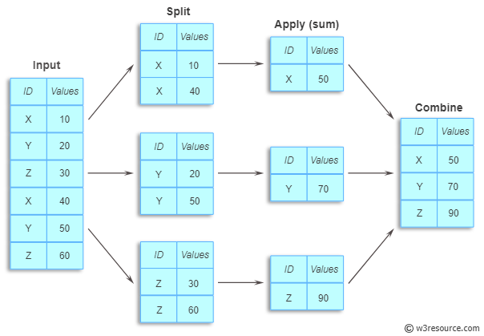

Slide 11
#1. Write a Pandas program to split the following dataframe into groups based on school code. Also check the type of GroupBy object.
import pandas as pd
pd.set_option('display.max_rows', None)
#pd.set_option('display.max_columns', None)
student_data = pd.DataFrame({
'school_code': ['s001','s002','s003','s001','s002','s004'],
'class': ['V', 'V', 'VI', 'VI', 'V', 'VI'],
'name': ['Alberto Franco','Gino Mcneill','Ryan Parkes', 'Eesha Hinton', 'Gino Mcneill', 'David Parkes'],
'date_Of_Birth ': ['15/05/2002','17/05/2002','16/02/1999','25/09/1998','11/05/2002','15/09/1997'],
'age': [12, 12, 13, 13, 14, 12],
'height': [173, 192, 186, 167, 151, 159],
'weight': [35, 32, 33, 30, 31, 32],
'address': ['street1', 'street2', 'street3', 'street1', 'street2', 'street4']},
index=['S1', 'S2', 'S3', 'S4', 'S5', 'S6'])
print("Original DataFrame:")
print(student_data)
print('\nSplit the said data on school_code wise:')
result = student_data.groupby(['school_code'])
for name,group in result:
print("\nGroup:")
print(name)
print(group)
print("\nType of the object:")
print(type(result))

Slide 12
#Write a Pandas program to split the following given dataframe into groups based on school code and class.
import pandas as pd
pd.set_option('display.max_rows', None)
#pd.set_option('display.max_columns', None)
student_data = pd.DataFrame({
'school_code': ['s001','s002','s003','s001','s002','s004'],
'class': ['V', 'V', 'VI', 'VI', 'V', 'VI'],
'name': ['Alberto Franco','Gino Mcneill','Ryan Parkes', 'Eesha Hinton', 'Gino Mcneill', 'David Parkes'],
'date_Of_Birth ': ['15/05/2002','17/05/2002','16/02/1999','25/09/1998','11/05/2002','15/09/1997'],
'age': [12, 12, 13, 13, 14, 12],
'height': [173, 192, 186, 167, 151, 159],
'weight': [35, 32, 33, 30, 31, 32],
'address': ['street1', 'street2', 'street3', 'street1', 'street2', 'street4']},
index=['S1', 'S2', 'S3', 'S4', 'S5', 'S6'])
print("Original DataFrame:")
print(student_data)
print('\nSplit the said data on school_code, class wise:')
result = student_data.groupby(['school_code', 'class'])
for name,group in result:
print("\nGroup:")
print(name)
print(group)

Slide 13
#Write a Pandas program to split the following given dataframe into groups based on school code and cast grouping as a list.
import pandas as pd
pd.set_option('display.max_rows', None)
#pd.set_option('display.max_columns', None)
student_data = pd.DataFrame({
'school_code': ['s001','s002','s003','s001','s002','s004'],
'class': ['V', 'V', 'VI', 'VI', 'V', 'VI'],
'name': ['Alberto Franco','Gino Mcneill','Ryan Parkes', 'Eesha Hinton', 'Gino Mcneill', 'David Parkes'],
'date_Of_Birth ': ['15/05/2002','17/05/2002','16/02/1999','25/09/1998','11/05/2002','15/09/1997'],
'age': [12, 12, 13, 13, 14, 12],
'height': [173, 192, 186, 167, 151, 159],
'weight': [35, 32, 33, 30, 31, 32],
'address': ['street1', 'street2', 'street3', 'street1', 'street2', 'street4']},
index=['S1', 'S2', 'S3', 'S4', 'S5', 'S6'])
print("Original DataFrame:")
print(student_data)
print('\nCast grouping as a list:')
result = student_data.groupby(['school_code'])
print(list(result))

Slide 14
how to visualize data with the help of the Matplotlib library of Python?
Matplotlib
Matplotlib is a low-level library of Python which is used for data visualization. It is easy to use and emulates MATLAB like graphs and visualization. This library is built on the top of NumPy arrays and consist of several plots like line chart, bar chart, histogram, etc. It provides a lot of flexibility but at the cost of writing more code.
To install Matplotlib type the below command in the terminal.
pip install matplotlib

Slide 15
Pyplot
Pyplot is a Matplotlib module that provides a MATLAB-like interface.
Matplotlib is designed to be as usable as MATLAB, with the ability to use Python and the advantage of being free and open-source.
Each pyplot function makes some change to a figure: e.g., creates a figure, creates a plotting area in a figure, plots some lines in a plotting area, decorates the plot with labels, etc.
The various plots we can utilize using Pyplot are Line Plot, Histogram, Scatter, 3D Plot, Image, Contour, and Polar.

Slide 16
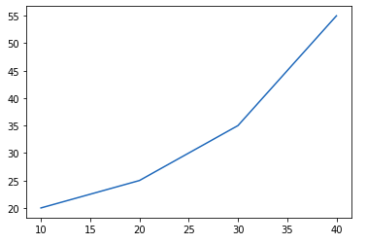
import matplotlib.pyplot as plt
# initializing the data
x = [10, 20, 30, 40]
y = [20, 25, 35, 55]
# plotting the data
plt.plot(x, y)
plt.show()

Slide 17
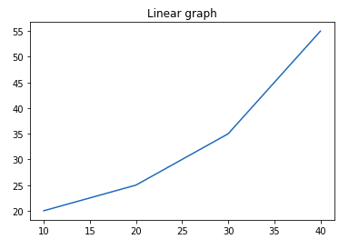
Adding Title
The title() method in matplotlib module is used to specify the title of the visualization depicted and displays the title using various attributes.
import matplotlib.pyplot as plt
# initializing the data
x = [10, 20, 30, 40]
y = [20, 25, 35, 55]
# plotting the data
plt.plot(x, y)
# Adding title to the plot
plt.title("Linear graph")
plt.show()

Slide 18
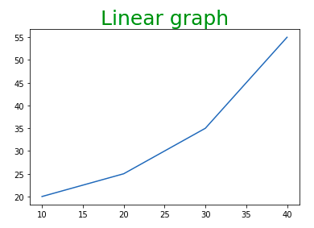
#We can also change the appearance of the title by using the parameters of this
import matplotlib.pyplot as plt
# initializing the data
x = [10, 20, 30, 40]
y = [20, 25, 35, 55]
# plotting the data
plt.plot(x, y)
# Adding title to the plot
plt.title("Linear graph", fontsize=25, color="green")
plt.show()

Slide 19
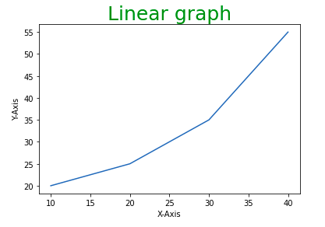
Adding X Label and Y Label
In layman’s terms, the X label and the Y label are the titles given to X-axis and Y-axis respectively. These can be added to the graph by using the xlabel() and ylabel() methods.
import matplotlib.pyplot as plt
# initializing the data
x = [10, 20, 30, 40]
y = [20, 25, 35, 55]
# plotting the data
plt.plot(x, y)
# Adding title to the plot
plt.title("Linear graph", fontsize=25, color="green")
# Adding label on the y-axis
plt.ylabel('Y-Axis')
# Adding label on the x-axis
plt.xlabel('X-Axis')
plt.show()

Slide 20
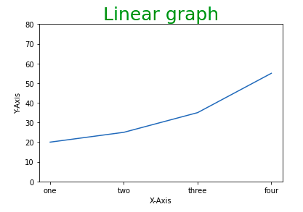
Setting Limits and Tick labels
You might have seen that Matplotlib automatically sets the values and the markers(points) of the X and Y axis, however, it is possible to set the limit and markers manually. xlim() and ylim() functions are used to set the limits of the X-axis and Y-axis respectively. Similarly, xticks() and yticks() functions are used to set tick labels.
import matplotlib.pyplot as plt
# initializing the data
x = [10, 20, 30, 40]
y = [20, 25, 35, 55]
# plotting the data
plt.plot(x, y)
# Adding title to the plot
plt.title("Linear graph", fontsize=25, color="green")
# Adding label on the y-axis
plt.ylabel('Y-Axis')
# Adding label on the x-axis
plt.xlabel('X-Axis')
# Setting the limit of y-axis
plt.ylim(0, 80)
# setting the labels of x-axis
plt.xticks(x, labels=["one", "two", "three", "four"])
plt.show()

Slide 21
Adding Legends
A legend is an area describing the elements of the graph. In simple terms, it reflects the data displayed in the graph’s Y-axis. It generally appears as the box containing a small sample of each color on the graph and a small description of what this data means.
The attribute bbox_to_anchor=(x, y) of legend() function is used to specify the coordinates of the legend, and the attribute ncol represents the number of columns that the legend has. Its default value is 1.

Slide 22
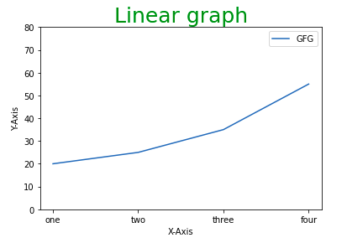
import matplotlib.pyplot as plt
# initializing the data
x = [10, 20, 30, 40]
y = [20, 25, 35, 55]
# plotting the data
plt.plot(x, y)
# Adding title to the plot
plt.title("Linear graph", fontsize=25, color="green")
# Adding label on the y-axis
plt.ylabel('Y-Axis')
# Adding label on the x-axis
plt.xlabel('X-Axis')
# Setting the limit of y-axis
plt.ylim(0, 80)
# setting the labels of x-axis
plt.xticks(x, labels=["one", "two", "three", "four"])
# Adding legends
plt.legend(["GFG"])
plt.show()

Slide 23
Figure class
Consider the figure class as the overall window or page on which everything is drawn. It is a top-level container that contains one or more axes. A figure can be created using the figure() method.

Slide 24
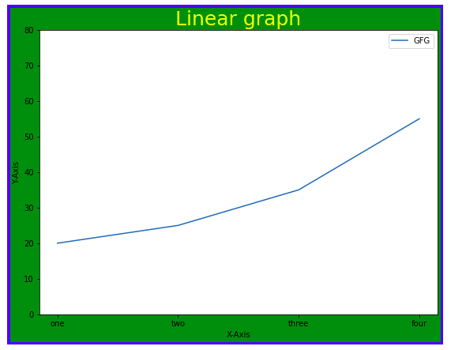
# Python program to show pyplot module
import matplotlib.pyplot as plt
from matplotlib.figure import Figure
# initializing the data
x = [10, 20, 30, 40] ,y = [20, 25, 35, 55]
# Creating a new figure with width = 7 inches
# and height = 5 inches with face color as
# green, edgecolor as red and the line width of the edge as 7
fig = plt.figure(figsize =(7, 5), facecolor='g',
edgecolor='b', linewidth=7)
# Creating a new axes for the figure
ax = fig.add_axes([1, 1, 1, 1])
# Adding the data to be plotted
ax.plot(x, y)
# Adding title to the plot
plt.title("Linear graph", fontsize=25, color="yellow")
# Adding label on the y-axis
plt.ylabel('Y-Axis’) # Adding label on the x-axis
plt.xlabel('X-Axis')
# Setting the limit of y-axis plt.ylim(0, 80)
# setting the labels of x-axis
plt.xticks(x, labels=["one", "two", "three", "four"])
# Adding legends
plt.legend(["GFG"])
plt.show()

Slide 25
Function Overloading

Slide 26
Finding Gross Pay
Three are three types of employees in Indian railways. They are regular, daily wages and consolidated employees. Gross Pay for the employees are calculated as follows:
regular employees - basic + hra + % of DA * basic
Daily wages – wages per hour * number of hours
Consolidated – fixed amount

Slide 27
PAC - Finding Gross pay
Input | Output | Logic Involved
Components for calculating gross pay | Gross pay | Based on type of employees – Calculate gross pay

Slide 28
Writing Functions
Same function name for all three type of employees
More meaningful and elegant way of doing things
I prefer the name - calculate_Gross_Pay for all types of employees

Slide 29

Look alike but exhibit different characters

Slide 30
Polymorphism
Refers to ‘one name having many forms’, ‘one interface doing multiple actions’.
In C++, polymorphism can be either
static polymorphism or
dynamic polymorphism.
C++ implements static polymorphism through
overloaded functions
overloaded operators

Slide 31
Polymorphism
Derived from the Greek many forms
Single name can be used for different purposes
Different ways of achieving the polymorphism:
1. Function overloading
2. Operator overloading
3. Dynamic binding

Slide 32
Overloading
Overloading – A name having two or more distinct meanings
Overloaded function - a function having more than one distinct meanings
Overloaded operator - When two or more distinct meanings are defined for an operator

Slide 33
Overloading
Operator overloading is inbuilt in C and C++.
‘-’ can be unary as well as binary
‘*’ is used for multiplication as well as pointers
‘<<‘, ‘>>’ used as bitwise shift as well as insertion and extraction operators
All arithmetic operators can work with any type of data

Slide 34
Function Overloading
C++ enables several functions of the same name to be defined, as long as they have different signatures.
This is called function overloading.
The C++ compiler selects the proper function to call by examining the number, types and order of the arguments in the call.

Slide 35
Overloaded functions are distinguished by their signatures
Signature - Combination of a function’s name and its parameter types (in order)
C++ compilers encodes each function identifier with the number and types of its parameters (sometimes referred to as name mangling or name decoration) to enable type-safe linkage.

Slide 36
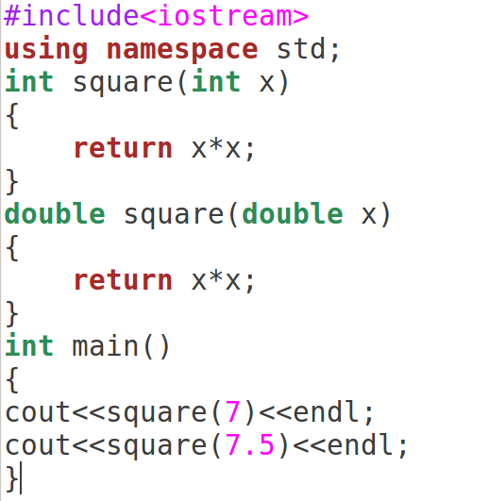

Slide 37
Signature of a Function
A function’s argument list (i.e., number and type of argument) is known as the function’s signature.
Functions with Same signature - Two functions with same number and types of arguments in same order
variable names doesn’t matter. For instance, following two functions have same signature.
void squar (int a, float b); //function 1
void squar (int x, float y);
37

Slide 38
Following code fragment overloads a function name prnsqr( ).
void prnsqr (int i);
//overloaded for integer #1
void prnsqr (char c);
//overloaded for character #2
void prnsqr (float f);
//overloaded for floats #3
//overloaded for floats #3
void prnsqr (double d);
//overloaded for double floats #4
38

Slide 39
void prnsqr (int i)
{
cout<<“Integer”<<i<<“’s square is”<<i*i<<“\n”;
}
void prnsqr (char c);
{
cout <<“No Square for characters”<<“\n”;
}
void prnsqr (float f)
{
cout<<“float”<<f <<“’s square is”<<f *f<<“\n”;
}
void prnsqr (double d)
{
cout <<“Double float”<<d<<“’s square is”<<d*d<<“\n’;
}
39

Slide 40
Where does Python belong to?
Python follows both functional oriented and object oriented programming approaches.
FEATURES OF OOPS:
Let’s understand the terms familiar in OOPS.
Class
Object
Encapsulation
Abstraction
Inheritance
Polymorphism
Abstract class

Slide 41
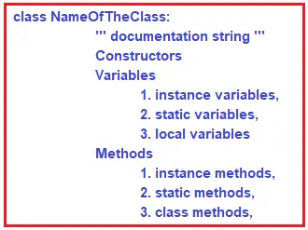
class Employee:
def display(self):
print("Hello my name is Prachi")
emp_obj = Employee()
emp_obj.display()
Hello my name is Prachi
class Employee:
def display(self):
print("Hello my name is Rahul")
emp_obj1 = Employee()
emp_obj1.display()
emp_obj2 = Employee()
emp_obj2.display()
Hello my name is Rahul
Hello my name is Rahul

